Slide 1

BUSINESS CASE 1 Segmenting Clients
Group 1 - Gelloni, Monfrinotti, Retif, Stampini
Fintech Lab Prof. Zenti

Slide 2
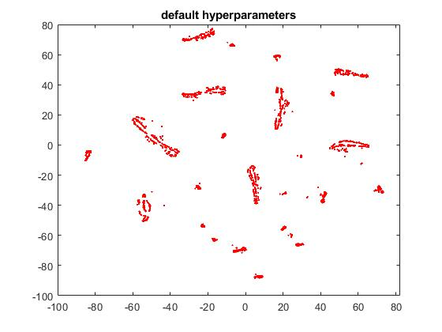
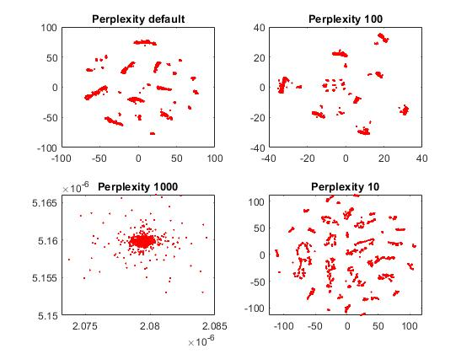
T-distributed Stochastic Neighbor Embedding
Modifiable hyperparameters:
Learning rate
Perplexity
Exaggeration
Perplexity
A value which says how to balance attention between local and global aspects of your data. Its range is between 5 and 50.
Roughly speaking, we can say that larger/denser data requires larger perplexity.
BC1 – Client Segmentation Gelloni, Monfrinotti, Retif, Stampini

Slide 3
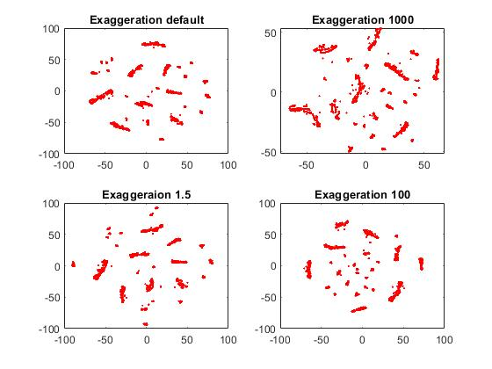
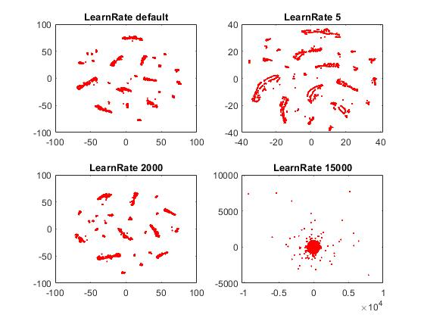
EXAGGERATION
A positive scalar no less than 1 specifying the tightness of the natural clusters in X at the start of the optimization (before iteration 100). A large exaggeration makes the learn larger joint probabilities of Y and creates relatively more space between clusters in Y.
LEARNING RATE
High LR - the data may look like a ‘ball’ with any point approximately equidistant from its nearest neighbours
Low LR - most points may look compressed in a dense cloud with few outliers. If the cost function gets stuck in a bad local minimum increasing the learning rate may help.
BC1 – Client Segmentation Gelloni, Monfrinotti, Retif, Stampini

Slide 4
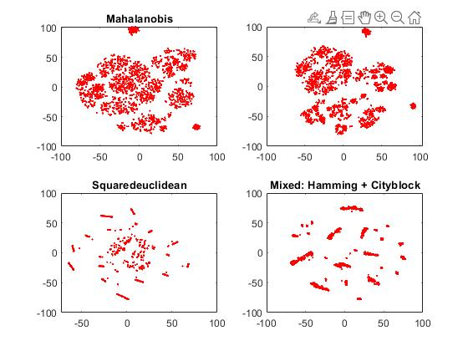
Distances
Our choices:
Hamming distances for categorical variables
L1 norm for numerical features
We combine them using relative weights in the function MixDistance
BC1 – Client Segmentation Gelloni, Monfrinotti, Retif, Stampini

Slide 5
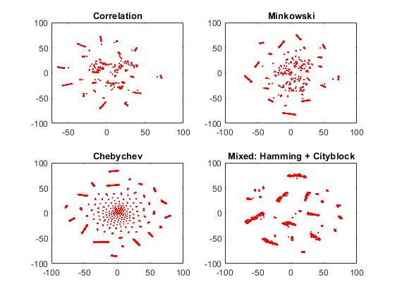
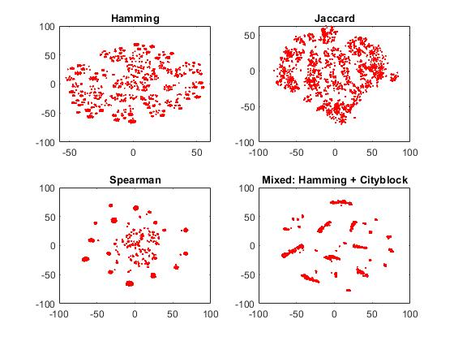
BC1 – Client Segmentation Gelloni, Monfrinotti, Retif, Stampini

Slide 6
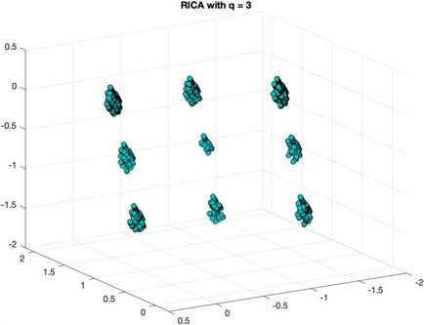
RICA – Reconstruction Independent Component Analysis
BC1 – Client Segmentation Gelloni, Monfrinotti, Retif, Stampini

Slide 7
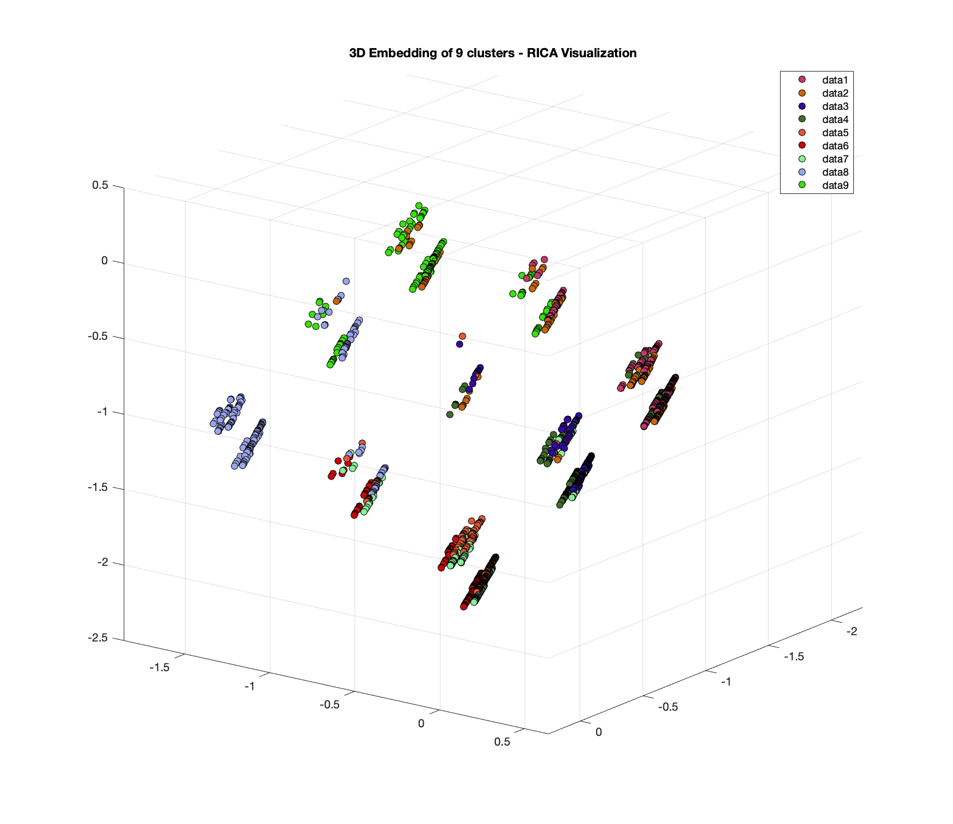
BC1 – Client Segmentation Gelloni, Monfrinotti, Retif, Stampini

Slide 8
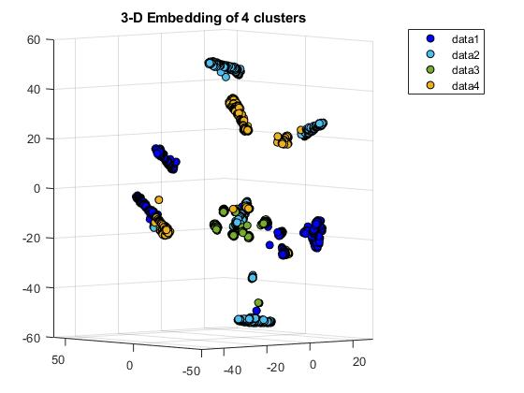
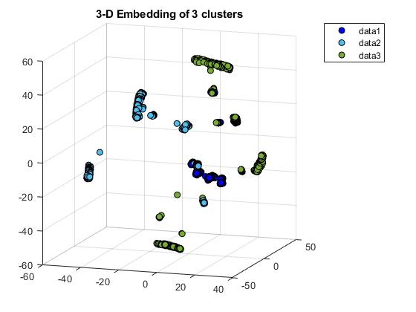
Clustering Algorithm: K-Medoids
BC1 – Client Segmentation Gelloni, Monfrinotti, Retif, Stampini

Slide 9
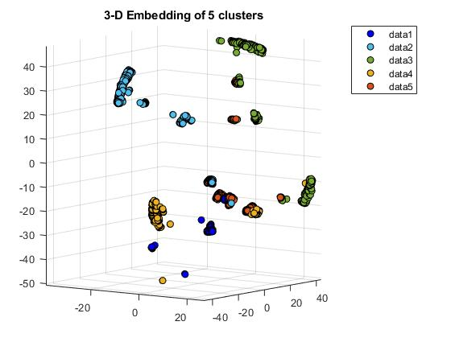
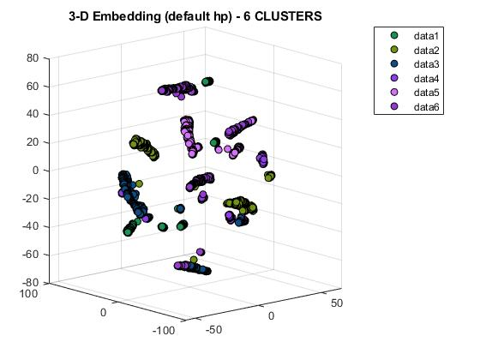
BC1 – Client Segmentation Gelloni, Monfrinotti, Retif, Stampini

Slide 10
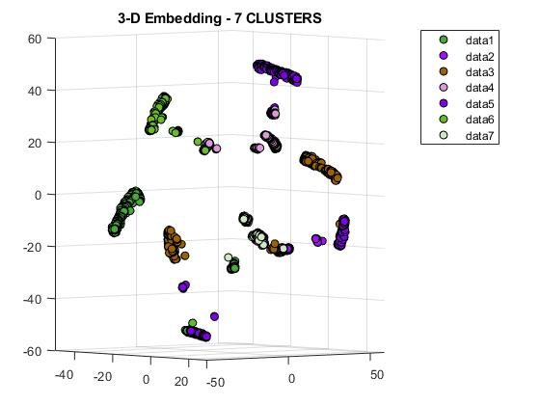
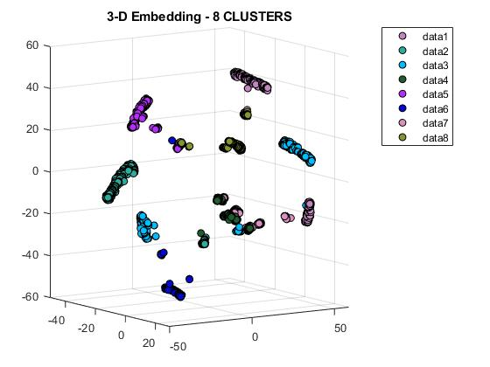
BC1 – Client Segmentation Gelloni, Monfrinotti, Retif, Stampini

Slide 11
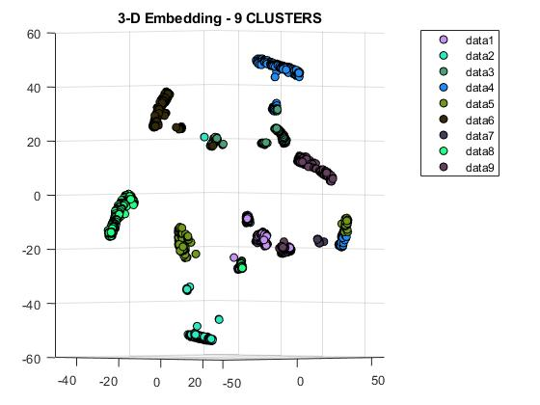
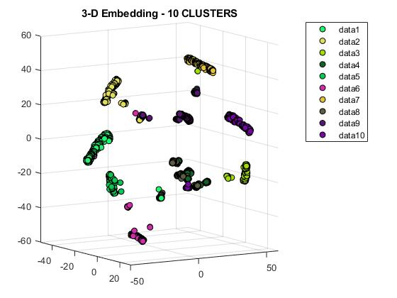
BC1 – Client Segmentation Gelloni, Monfrinotti, Retif, Stampini

Slide 12
CLUSTERING EVALUATION
Calinski-Harabasz criterion
Davies-Bouldin criterion
Silhouette criterion
BC1 – Client Segmentation Gelloni, Monfrinotti, Retif, Stampini

Slide 13
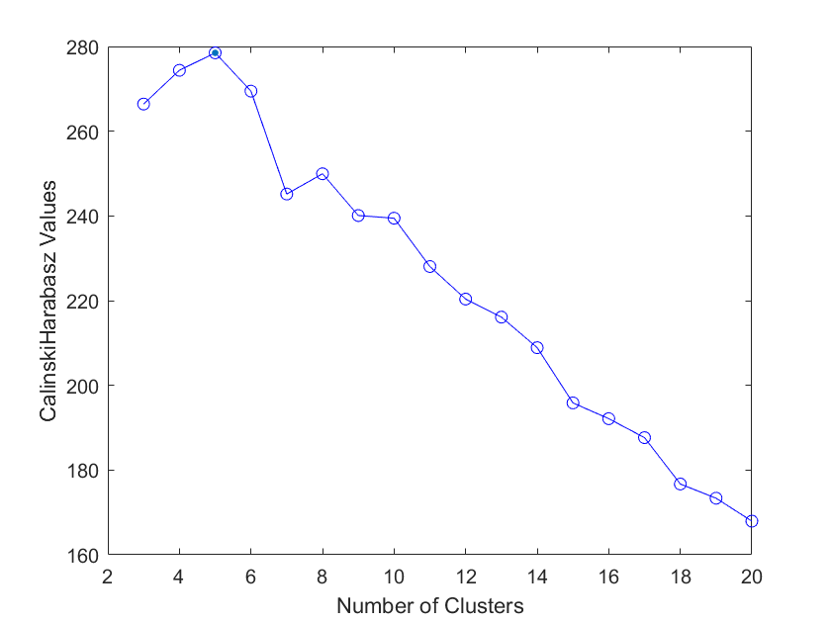
Calinski-Harabasz Criterion
BC1 – Client Segmentation Gelloni, Monfrinotti, Retif, Stampini

Slide 14
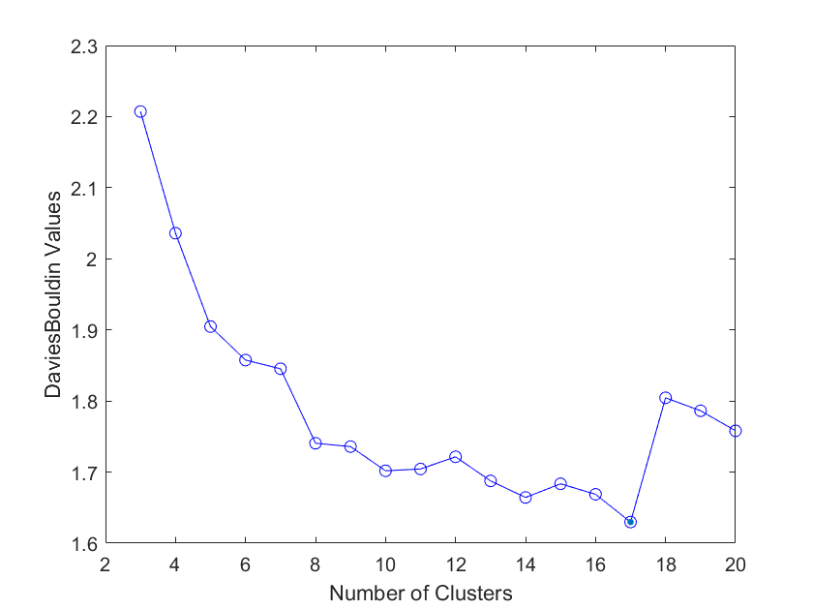
Davies-Bouldin Criterion
BC1 – Client Segmentation Gelloni, Monfrinotti, Retif, Stampini

Slide 15
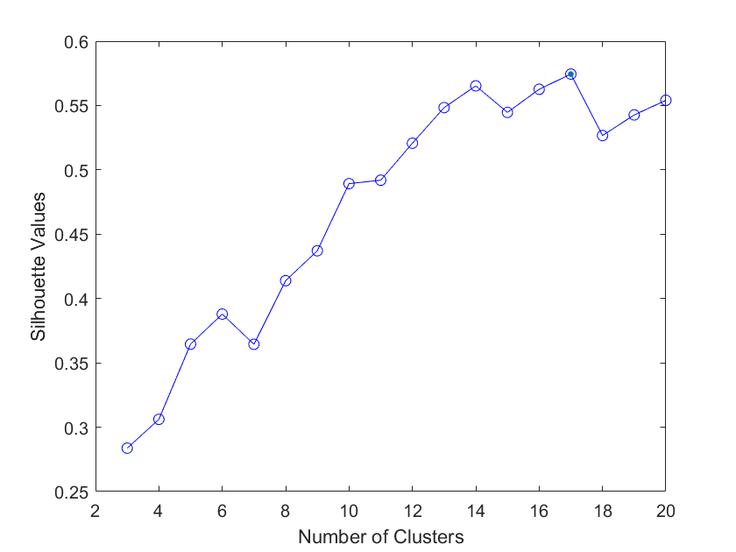
Silhouette Criterion
BC1 – Client Segmentation Gelloni, Monfrinotti, Retif, Stampini

Slide 16
Client Segmentation Looking for personas from 10 Clusters
BC1 – Client Segmentation Gelloni, Monfrinotti, Retif, Stampini

Slide 17

Cluster 1 Risk-Adverse, Elderly Client from Bergamo
Regular middle-aged workers and retirees
Northern Italy – medium size cities
Not financially educated
Non-Investors
Bank Friendly
BC1 – Client Segmentation Gelloni, Monfrinotti, Retif, Stampini

Slide 18

Cluster 4 Small Town-Hard Worker
Central Italy
Worker/employee
Small town
Very bank friendly
Average good income
Tend to have a significant amount of savings
Tend to invest money and sustainable
BC1 – Client Segmentation Gelloni, Monfrinotti, Retif, Stampini

Slide 19

Cluster 9 Investing Worker from Bergamo
Pro-Investment Attitude
Medium sized cities
Good Wealth Index (Range: 0.4-0.9, Median: 0.543)
Financially Educated (Median: 0.53)
Savings-Careful (Range 0.5-0.8)
BC1 – Client Segmentation Gelloni, Monfrinotti, Retif, Stampini

